Slide 1


Sree Matangi.K
16/10/2025

Slide 2

Outline
Executive Summary
Introduction
Methodology
Results
Conclusion
Appendix

Slide 3
Executive Summary
Summary of Methodologies:
Exploratory Data Analysis (EDA): Analyzed SpaceX launch datasets to identify correlations between launch sites, payload mass, and success rates using visualizations in Matplotlib and Seaborn.
Interactive Geospatial Analytics: Used Folium to map launch sites, mark successful and failed launches, and calculate distances to coastlines, cities, highways, and railways for geographic insights.
Dashboard Visualization: Built a Plotly Dash dashboard to explore launch success distribution and payload vs success correlations interactively.
Machine Learning Models: Trained Logistic Regression, SVM, Decision Tree, and KNN classifiers on historical launch data to predict first-stage landing outcomes, with hyperparameter tuning via GridSearchCV.
Summary of Results:
Launch sites near the coast and with certain transport proximities exhibited higher success rates.
The payload mass showed a noticeable correlation with the success probability in the visualisations.
Dash dashboard enabled intuitive exploration of success rates by site and payload range.
Among ML models, Logistic Regression and SVM achieved the highest accuracy, effectively predicting first-stage landings with minimal false positives.
The combined approach demonstrates that data-driven insights can guide both operational decisions and predictive modelling for SpaceX launch outcomes.

Slide 4
Introduction
Project Background & Context:
SpaceX has revolutionized space travel by reusing the Falcon 9 first stage, drastically reducing launch costs. Understanding what factors influence launch success and first-stage landings is crucial for operational planning, cost efficiency, and safety. This project combines data analytics, interactive mapping, and machine learning to explore launch patterns and predict landing outcomes.
Problems We Want to Find Answers To:
Which factors most strongly influence launch success? (e.g., payload mass, launch site)
How do geographic factors, such as proximity to coasts, cities, and transport routes, affect site selection?
Can we accurately predict whether a Falcon 9 first stage will land safely using historical data?
Which machine learning models are most effective for predicting landing outcomes?

Slide 5

Section 1

Slide 6
Methodology
Executive Summary
Data collection methodology:
Gathered SpaceX launch datasets, including launch site details, payload mass, and mission outcomes.
Performed data cleaning, handling missing values, and formatting for analysis.
Perform data wrangling
Standardized data using preprocessing techniques.
Aggregated and grouped data by launch site and mission outcome to extract meaningful patterns.

Slide 7
Methodology
Standardized features (e.g., payload mass) using StandardScaler for predictive modelling.
Split datasets into training and testing subsets for machine learning evaluation.
Converted categorical labels (e.g., launch success/failure) into machine-readable formats.
Perform exploratory data analysis (EDA) using visualization and SQL.
Used Matplotlib and Seaborn to visualize correlations between payload mass, launch site, and success rate.
Explored statistical relationships and performed summary statistics queries using SQL.
Identified trends such as higher success rates at certain launch sites and payload ranges.
Perform interactive visual analytics using Folium and Plotly Dash
Mapped launch sites and success/failure outcomes using Folium.

Slide 8
Methodology
Calculated distances to coastlines, cities, highways, and railways for geospatial insights.
Built Plotly Dash dashboard for interactive exploration of launch success vs payload mass.
Perform predictive analysis using classification models
Trained multiple models: Logistic Regression, SVM, Decision Tree, and KNN to predict first-stage landing outcomes
.Hyperparameters tuned with GridSearchCV using cross-validation.
Models evaluated with accuracy scores and confusion matrices, identifying false positives and overall prediction reliability.

Slide 9
Data Collection
Describe how data sets were collected.
You need to present your data collection process use key phrases and flowcharts

Slide 10
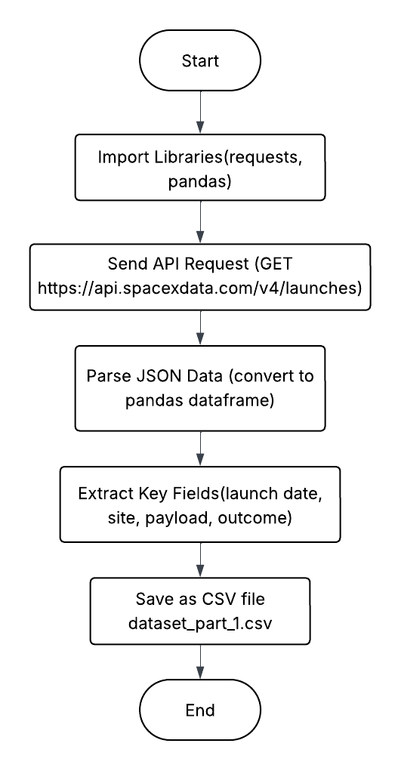
Data Collection – SpaceX API
Data was collected using the official SpaceX REST API, which provides structured JSON data about past and upcoming rocket launches.
Key data fields included:
Flight number, Launch date, and Launch site, Payload mass and orbit type, Rocket booster version, Landing outcome (success/failure/no attempt)
Output: Successfully retrieved launch records from 2010 to 2020.
Generated spacex_launch_data.csv for downstream EDA and SQL tasks.
Github: https://github.com/sreematangi04/IBM-Data-Science-Capstone/blob/main/module%201/jupyter-labs-spacex-data-collection-api.ipynb
Flowchart of
SpaceX API calls

Slide 11
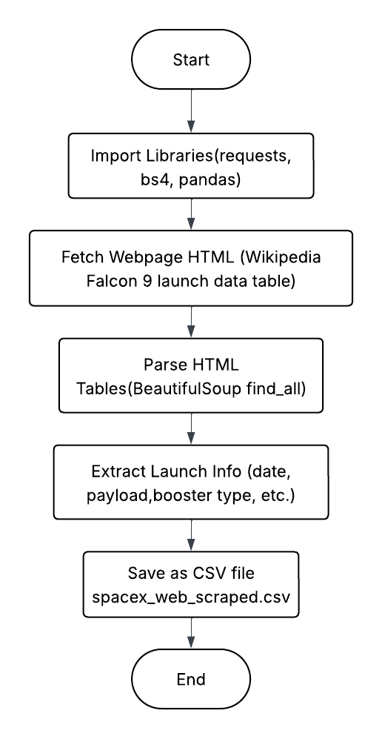
Data Collection - Scraping
For additional details not available in the API (e.g., booster performance metrics and payload manufacturer info), web scraping was performed from Wikipedia’s Falcon 9 launch records using BeautifulSoup and requests.
GitHub: https://github.com/sreematangi04/IBM-Data-Science-Capstone/blob/main/module%201/jupyter-labs-webscraping-bak-2025-10-12-12-00-08Z.ipynb
Flowchart of
web scraping

Slide 12
Data Wrangling
Describe how data were processed
You need to present your data wrangling process using key phrases and flowcharts
Add the GitHub URL of your completed data wrangling related notebooks, as an external reference and peer-review purpose

Slide 13
EDA with Data Visualization
Summarize what charts were plotted and why you used those charts
Add the GitHub URL of your completed EDA with data visualization notebook, as an external reference and peer-review purpose

Slide 14
EDA with SQL
Using bullet point format, summarize the SQL queries you performed
Add the GitHub URL of your completed EDA with SQL notebook, as an external reference and peer-review purpose

Slide 15
Build an Interactive Map with Folium
Summarize what map objects such as markers, circles, lines, etc. you created and added to a folium map
Explain why you added those objects
Add the GitHub URL of your completed interactive map with Folium map, as an external reference and peer-review purpose

Slide 16
Build a Dashboard with Plotly Dash
Summarize what plots/graphs and interactions you have added to a dashboard
Explain why you added those plots and interactions
Add the GitHub URL of your completed Plotly Dash lab, as an external reference and peer-review purpose

Slide 17
Predictive Analysis (Classification)
Summarize how you built, evaluated, improved, and found the best performing classification model
You need present your model development process using key phrases and flowchart
Add the GitHub URL of your completed predictive analysis lab, as an external reference and peer-review purpose

Slide 18
Results
Exploratory data analysis results
Interactive analytics demo in screenshots
Predictive analysis results

Slide 19

Section 2

Slide 20
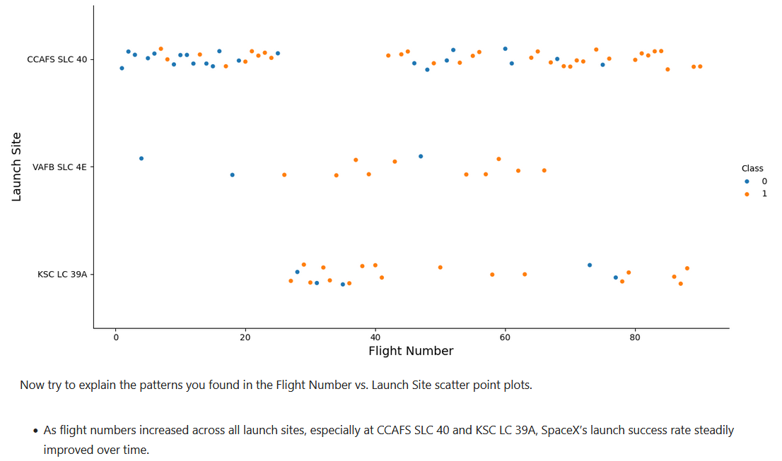
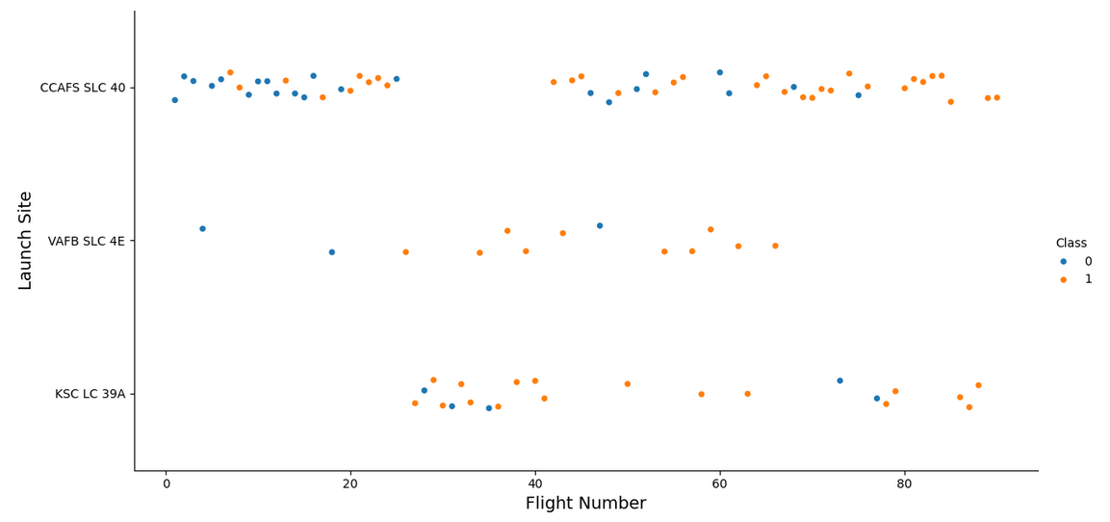
Flight Number vs. Launch Site
Flight Number vs. Launch Site
Scatter plot with explanations

Slide 21
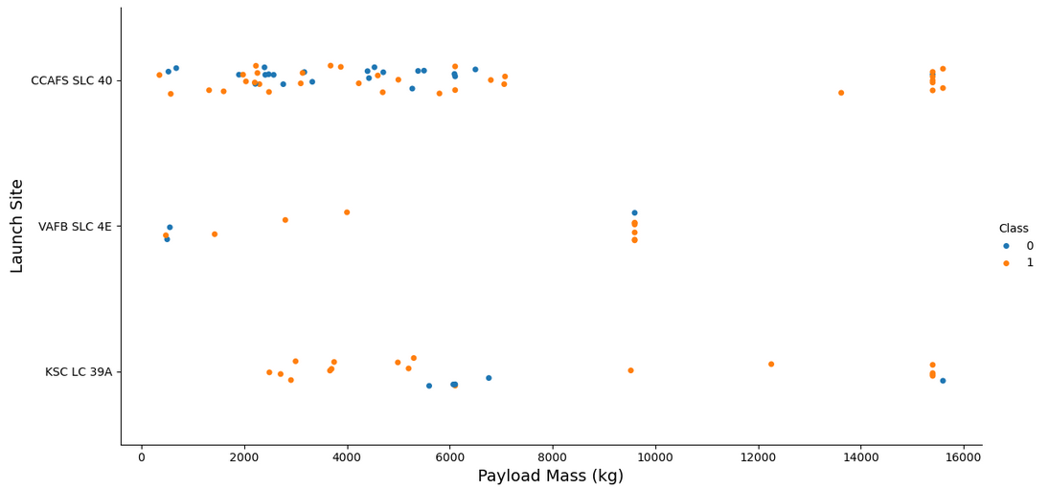
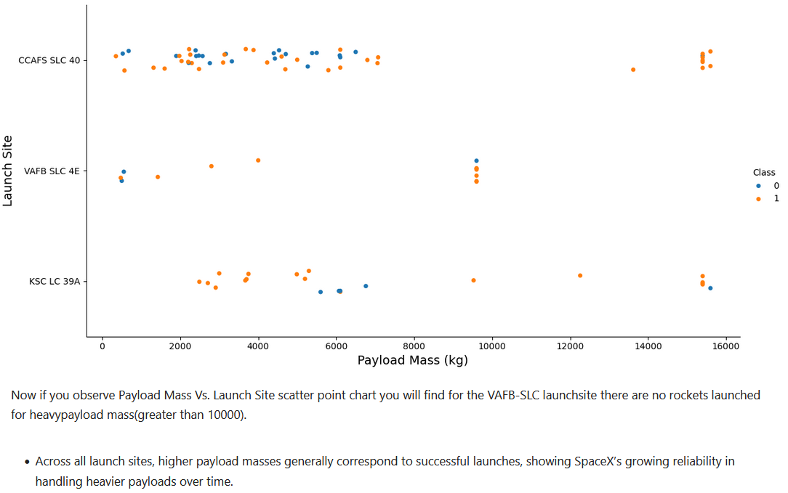
Payload vs. Launch Site
Payload vs. Launch Site
Scatter plot with explanations

Slide 22
Success Rate vs. Orbit Type
Show a bar chart for the success rate of each orbit type
Show the screenshot of the scatter plot with explanations

Slide 23
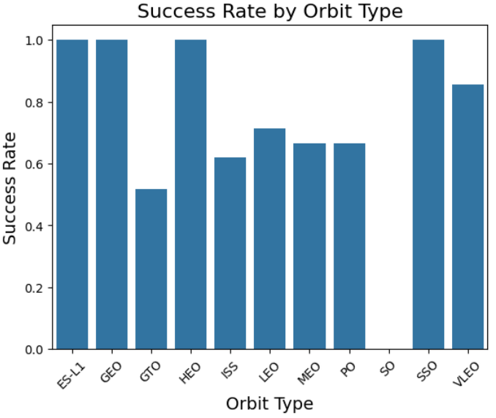
Flight Number vs. Orbit Type
Flight number vs. Orbit type
Scatter plot with explanations

Slide 24
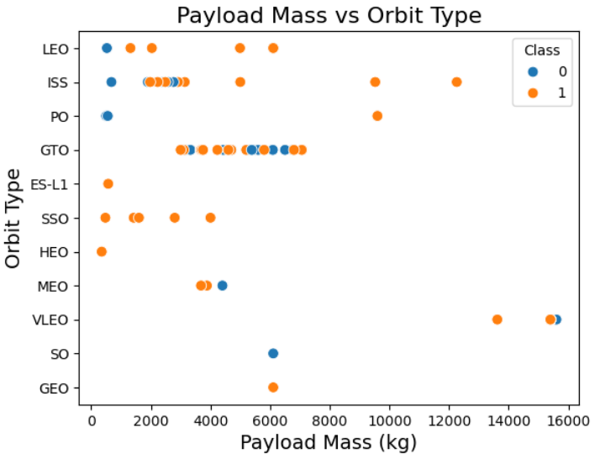
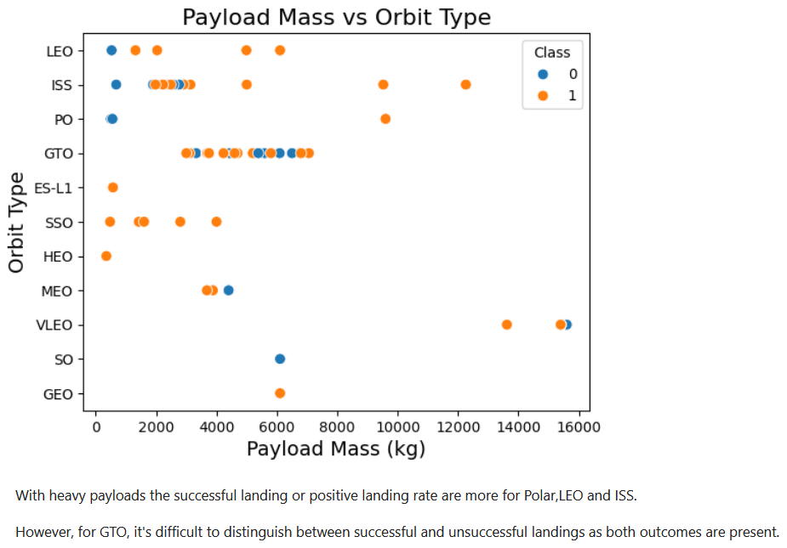
Payload vs. Orbit Type
Payload vs. orbit type
Scatter plot with explanations

Slide 25
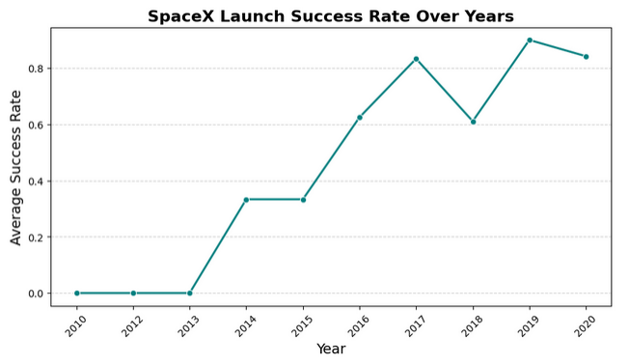
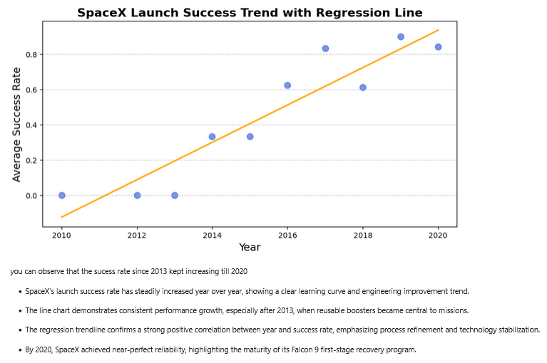
Launch Success Yearly Trend
Line chart of yearly average success rate
Show the screenshot of the scatter plot with explanations

Slide 26
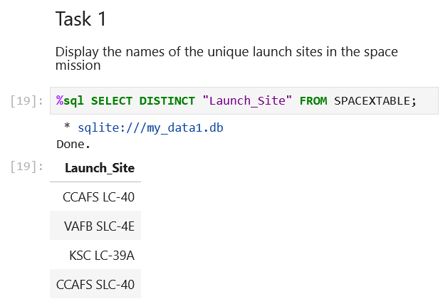
All Launch Site Names
Find the names of the unique launch sites
Present your query result with a short explanation here

Slide 27
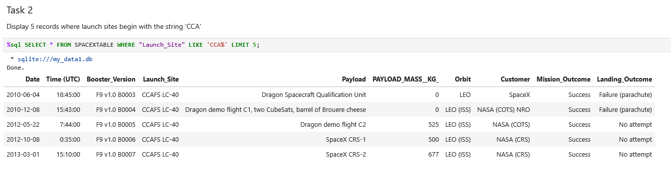
Launch Site Names Begin with 'CCA'
Find 5 records where launch sites begin with `CCA`
Present your query result with a short explanation here

Slide 28
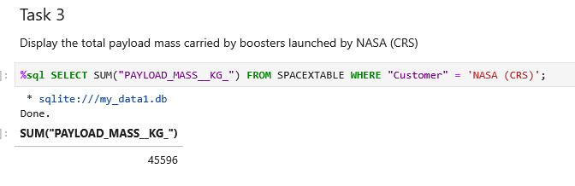
Total Payload Mass
Calculate the total payload carried by boosters from NASA
Present your query result with a short explanation here

Slide 29
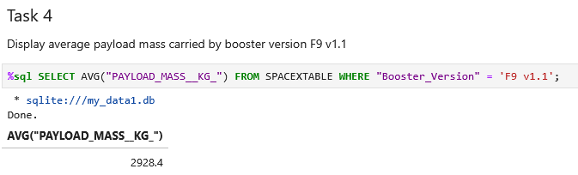
Average Payload Mass by F9 v1.1
Calculate the average payload mass carried by booster version F9 v1.1
Present your query result with a short explanation here

Slide 30
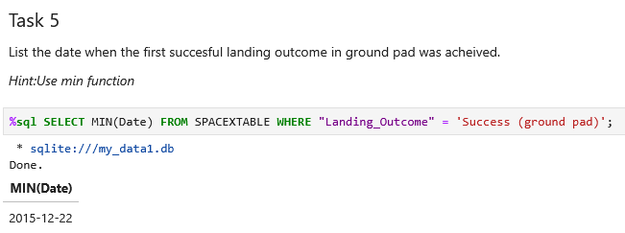
First Successful Ground Landing Date
Find the dates of the first successful landing outcome on ground pad
Present your query result with a short explanation here

Slide 31
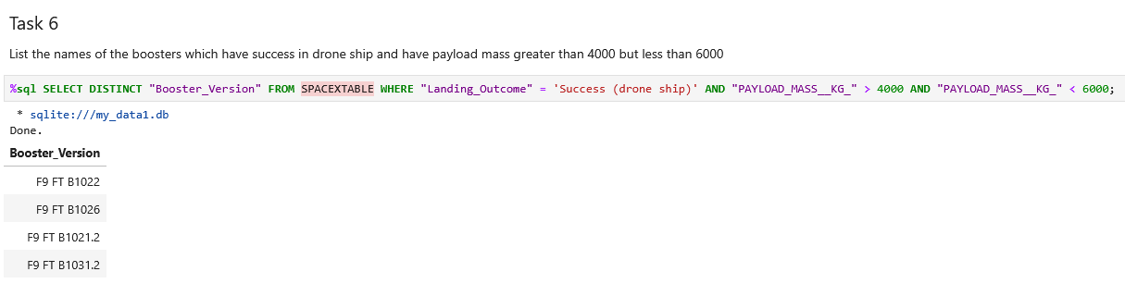
Successful Drone Ship Landing with Payload between 4000 and 6000
List the names of boosters which have successfully landed on drone ship and had payload mass greater than 4000 but less than 6000
Present your query result with a short explanation here

Slide 32
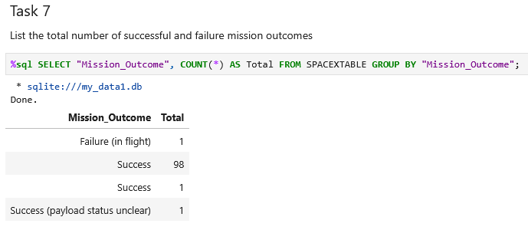
Total Number of Successful and Failure Mission Outcomes
Calculate the total number of successful and failure mission outcomes
Present your query result with a short explanation here

Slide 33
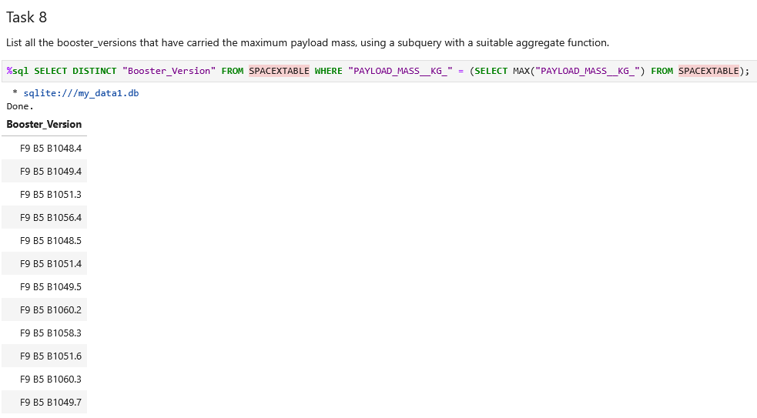
Boosters Carried Maximum Payload
List the names of the booster which have carried the maximum payload mass
Present your query result with a short explanation here

Slide 34
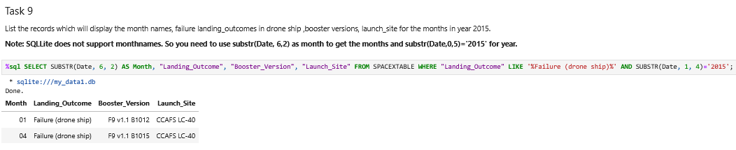
2015 Launch Records
List the failed landing_outcomes in drone ship, their booster versions, and launch site names for in year 2015
Present your query result with a short explanation here

Slide 35
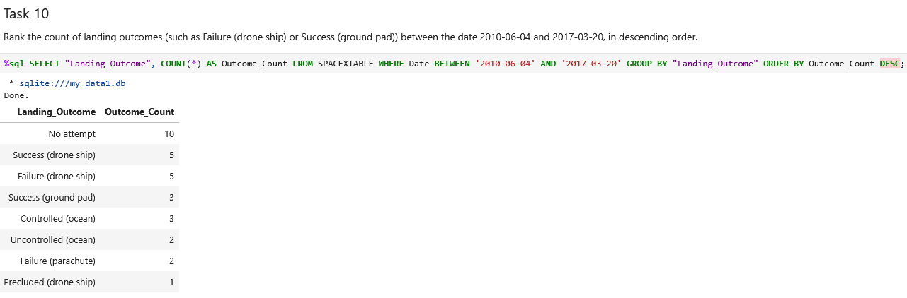
Rank Landing Outcomes Between 2010-06-04 and 2017-03-20
Rank the count of landing outcomes (such as Failure (drone ship) or Success (ground pad)) between the date 2010-06-04 and 2017-03-20, in descending order
Present your query result with a short explanation here

Slide 36

Section 3

Slide 37
<Folium Map Screenshot 1>
Replace <Folium map screenshot 1> title with an appropriate title
Explore the generated folium map and make a proper screenshot to include all launch sites’ location markers on a global map
Explain the important elements and findings on the screenshot

Slide 38
<Folium Map Screenshot 2>
Replace <Folium map screenshot 2> title with an appropriate title
Explore the folium map and make a proper screenshot to show the color-labeled launch outcomes on the map
Explain the important elements and findings on the screenshot

Slide 39
<Folium Map Screenshot 3>
Replace <Folium map screenshot 3> title with an appropriate title
Explore the generated folium map and show the screenshot of a selected launch site to its proximities such as railway, highway, coastline, with distance calculated and displayed
Explain the important elements and findings on the screenshot

Slide 40

Section 4

Slide 41
<Dashboard Screenshot 1>
Replace <Dashboard screenshot 1> title with an appropriate title
Show the screenshot of launch success count for all sites, in a piechart
Explain the important elements and findings on the screenshot

Slide 42
<Dashboard Screenshot 2>
Replace <Dashboard screenshot 2> title with an appropriate title
Show the screenshot of the piechart for the launch site with highest launch success ratio
Explain the important elements and findings on the screenshot

Slide 43
<Dashboard Screenshot 3>
Replace <Dashboard screenshot 3> title with an appropriate title
Show screenshots of Payload vs. Launch Outcome scatter plot for all sites, with different payload selected in the range slider
Explain the important elements and findings on the screenshot, such as which payload range or booster version have the largest success rate, etc.

Slide 44

Section 5

Slide 45
Classification Accuracy
Visualize the built model accuracy for all built classification models, in a bar chart
Find which model has the highest classification accuracy

Slide 46
Confusion Matrix
Show the confusion matrix of the best performing model with an explanation

Slide 47
Conclusions
Point 1
Point 2
Point 3
Point 4
…

Slide 48
Appendix
Include any relevant assets like Python code snippets, SQL queries, charts, Notebook outputs, or data sets that you may have created during this project

Slide 49


